Slide 1


SICAP Presentation
“The entrepreneurial Pivot”
November 2012

Slide 2


Presentation Themes
TIO Networks
A little background on myself
Examples of the pivot
TIO’s Story and Trajectory over the years
Ways to “pivot”
Q & A

Slide 3
Quick Highlights on me
    Founder and President & CEO of TIO Networks
    Winner of BIV’s 40 under 40 award
    Recognized as a Fast 50 or Fast 500 CEO 5x
    Was recognized as a Profit 100 CEO 4x
    Was inducted into Profit 100’s “Hall of Fame” for being the youngest CEO on the Profit 100 list in 2003
    Raised approx $30M+ worth of Venture Capital from major Canadian and US institutions including Hewlett Packard, AGF Funds, Scotia Bank, Shore Bank etc…
TSX.V:TNC
Notes:
3

Slide 4
Quick Highlights on me
  Education
      B.A.Sc in Civil Engineering Grad 97 (UBC)
      Short form courses and programs:
        Program on Negotiation – Harvard Law (2001)
        Deepak Chopra – Synchrodestiny (2005 & 2006)
        Michael Gerber – In the Dreaming Room (2007)
        School of self-learning!
  PR Credits: (over 1000 instances over last 10 yrs)
    TV: CNBC, CNN, Bloomberg TV, etc…
    Daily Newspapers: National & local (US & Can)
    IT Publications: Computerworld, report on wireless, etc…
    Business Publications: Canadian Business, Dow Jones, etc…
    Industry Publications: kiosk Retail, c-store related, etc...
TSX.V:TNC
Notes:
4

Slide 5
Where there is a WILL, There is a WAY
TIO Networks

Slide 6
Examples of Pivots
TIO Networks

Slide 7
Burbn → Instagram
    Instagram started as “Burbn”
    Burbn’s primary functions were to let users check-in to locations, make future plans with acquaintances, earn points for hanging out with friends and post pictures
    It later decided to “Zoom in” and just focus on mobile photo sharing.
    Within 2 years it was sold for $1B to Facebook
TSX.V:TNC
Notes:
7

Slide 8
Facemash → Facebook
    Then - Started as “Facemash” a site comparable to “HotorNot.com” putting two pictures of different people next to one another and asking the user to identify which was was “hotter” or better looking
    Today – its Facebook. The leader in web identity on the Internet. A digital directory of more than 1B people
TSX.V:TNC
Notes:
8

Slide 9
Confinity→ Paypal
    Then - it started as Confinity, a cryptography company designed for exchanging money over Palm Pilots. It didn't work well, but they did identify the lucrative market space of enabling people to take credit card payments.
    Now – PayPal is the brand-name way to pay for items online.
TSX.V:TNC
Notes:
9

Slide 10
Apple
    Then - They were a company that revolved around selling elementary computer kits.
    Now – They make their own computers. No assembly required. More than computers, they create the words most innovative consumer devices. And they are the world’s most valuable company
TSX.V:TNC
Notes:
10

Slide 11
Microsoft
    Then - They created BASIC interpreters for the Altair 8800
    Now – They became the architects behind Windows in 1984 and it's now the most popular operating system in the world for personal computers.
    They are in danger of missing a pivot! If they do, they will face an uphill future battle and likely continue to lose relevance.
TSX.V:TNC
Notes:
11

Slide 12
High Level TIO Overview
TIO Networks

Slide 13
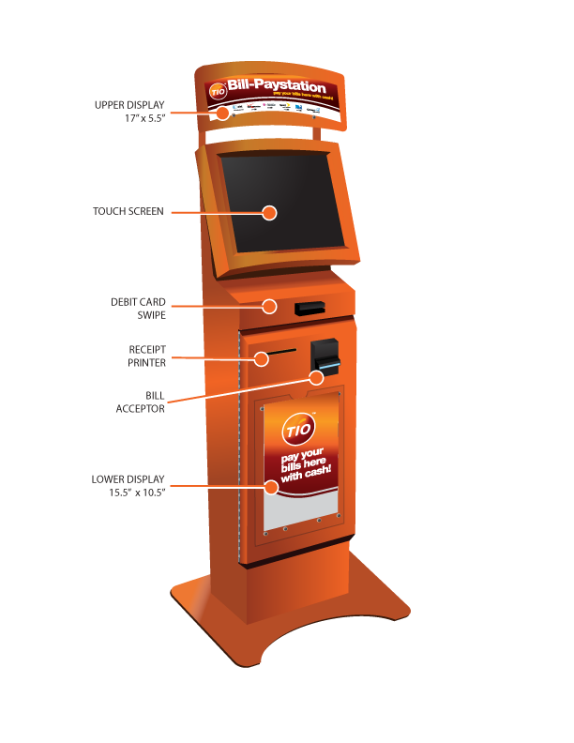
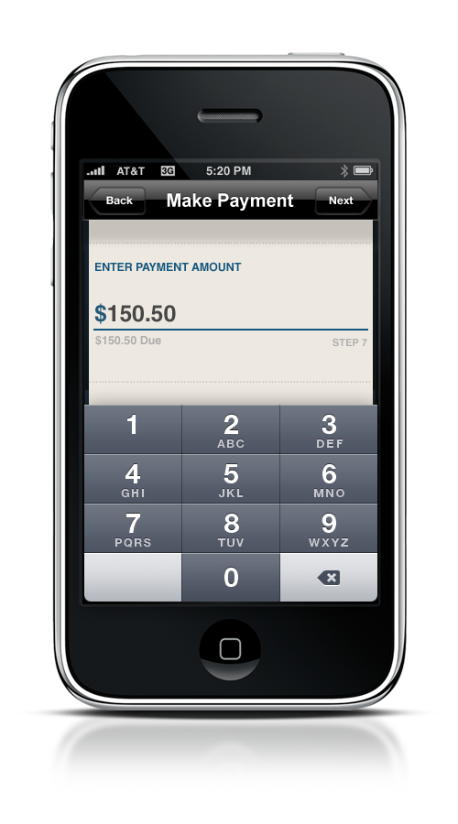
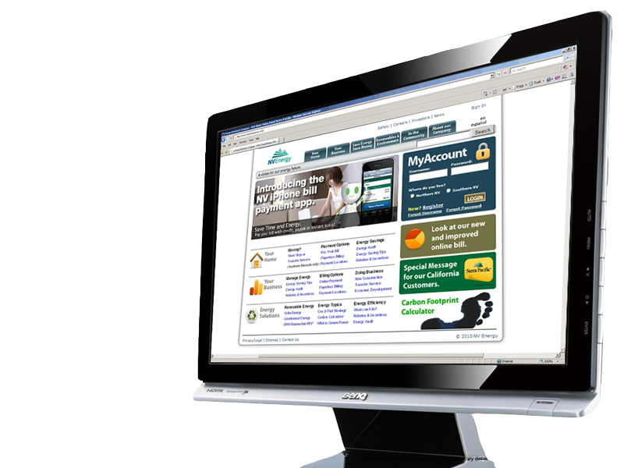
Integrated Bill Pay Solutions
Kiosk
TIO Express POS
Mobile
2,000+ Self Serve Kiosks In Service
More Than 4000 Instances of Web POS Software Activated
300,000+ Online/Mobile Subscribers

Slide 14
TIO Networks – High level Overview
Leading Biller Remittance Network in the United States
Financial Turnover (in $ Billions/yr) | 1.0
Transactions (in Millions/yr) | 18+
Total number of locations serviced | 57,000
# of over the counter locations | 55,000
# of Self Service Kiosks serviced | 2,000
# of Devices owned by TIO | 1,000
Number of unique customers served each month | 1M+
# of billers supported by TIO | 10,000+
# of "expedited" or "same day" billers | 800+

Slide 15
Key Partnerships
Biller Retail Network/Payment System
Cricket Wireless ACE Cash Express First Data
AT&T Wireless Albertsons GreenDot
Metro PCS Best Buy IPP of America
PG&E Circle K iQMetrix
Arizona Power Service ExxonMobil Nexxo Financial
Sempra Utilities Mapco Wal-mart
Georgia Power Walgreens Budget PrePay
Cox Communications Valero Online Resources
Comcast Cable Sunoco DolEx Dollar Express
Qwest Communications MoneyGram BAF Global Group Ltd
Notes:
TIO is the exclusive provider of bill payments to Wal-mart’s employees through its partnership with First Data. TIO’s PG&E mobile bill pay app is the top rated pure bill pay app on the Apple App store. TIO is now the exclusive provider of payments for AT&T Wireless in their agent channel. Currently processes bill payments for GreenDot via GreenDot’s moneypak.com website

Slide 16
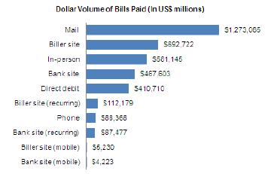
Market Opportunity
Walk-In Payments Exceed $500 Billion Annually
Kiosks Generate Over 20% Of In-Person Payments
Over 200 Million Bills Will Be Paid Via Mobile In 2013
Substantial Opportunity for Mobile Growth
Source: Aite Group, TIO Networks

Slide 17
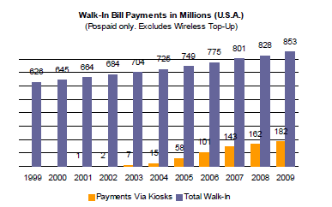
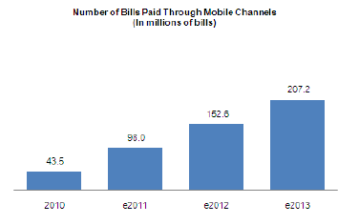
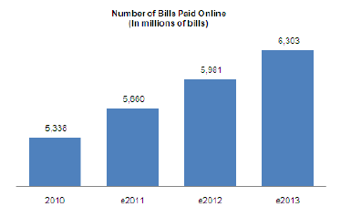
Growth In Every Channel
Source: Aite Group, TIO Networks
Notes:
Do you have forecasts for walk-in/kiosks?

Slide 18
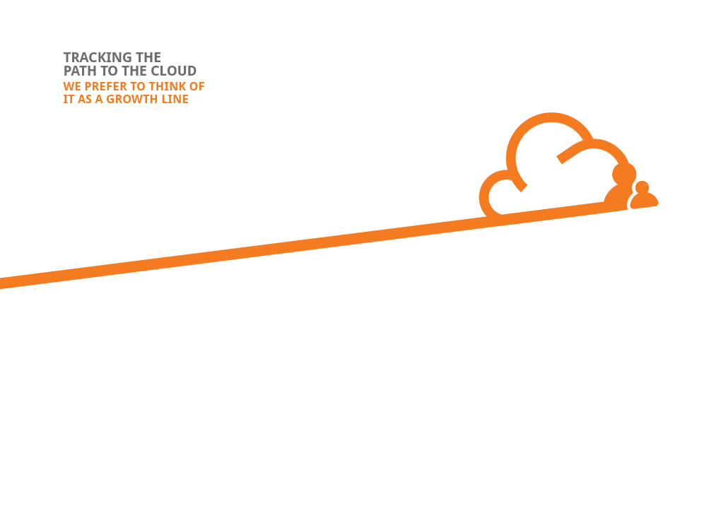
2010
2011
2009
2007
2008
2013+
Today
TIO drives non-transaction revenue with “prosumer” services
Dec 2010
First production transaction with native web platform occurs – TIO now live with 4 channels
Oct 2008
First Mobile transaction
May 2006
TIO becomes EBITDA profitable
TIO processes its first non-kiosk transaction
CY Q4 2012
TIO activates its 1Mth smart TIO profile
Sept 2009
Feb 2008
TIO initiates R&D efforts against multi-channel expansion vision
TIO processes first API transaction

Slide 19
Revenue, Transactions Climbing
Source: Forecast Data from NCP Northland

Slide 20
Our latest “Pivot”
Moving from owning a “transaction” to owning a “customer”
TIO Networks

Slide 21
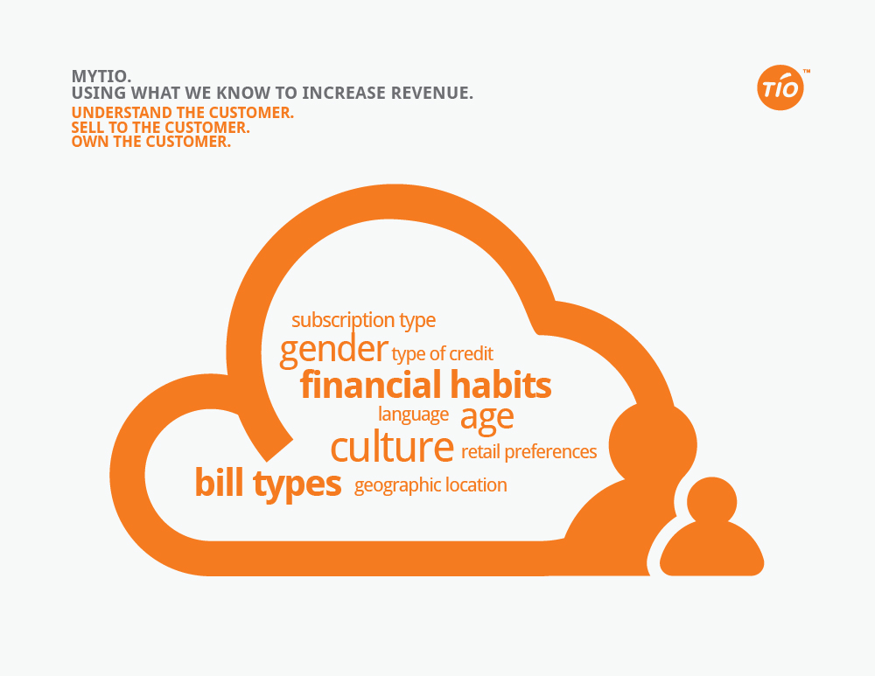

Slide 22
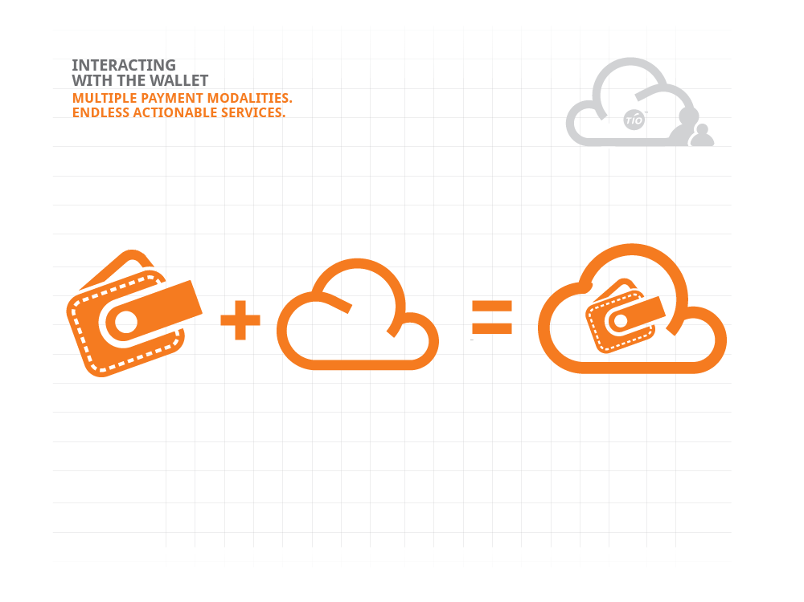

Slide 23
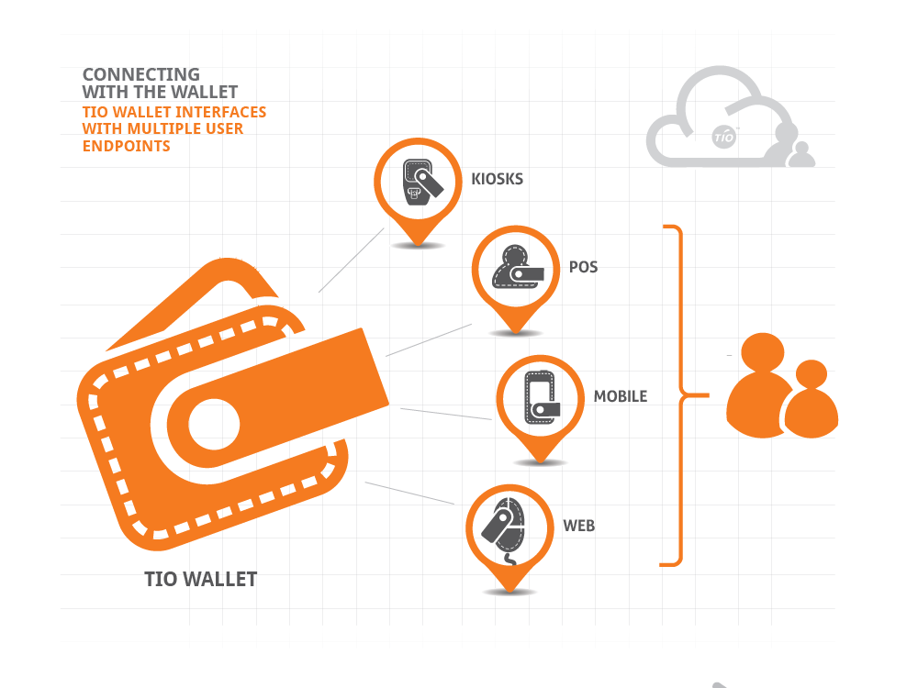

Slide 24
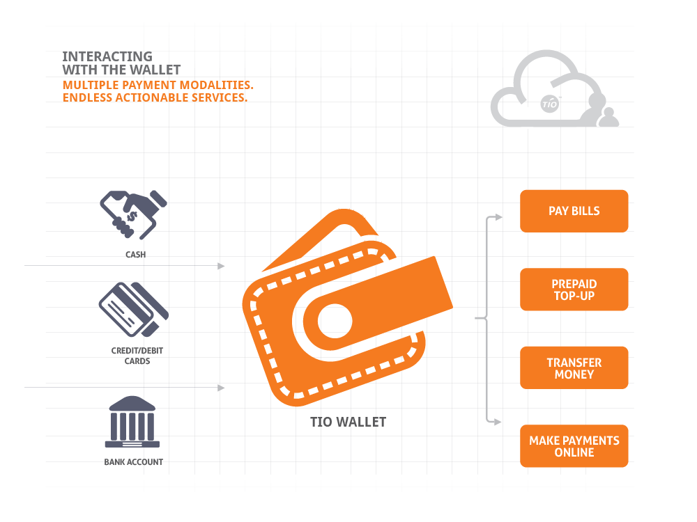

Slide 25
Types of Pivots
TIO Networks

Slide 26
Types of Pivots (Eric Ries)
Zoom-in pivot. In this case, what previously was considered a single feature in a product becomes the whole product.
Zoom-out pivot. In the reverse situation, sometimes a single feature is insufficient to support a customer set. In this type of pivot, what was considered the whole product becomes a single feature of a much larger product.
Customer segment pivot. Your product may attract real customers, but not the ones in the original vision.
Customer need pivot. Early customer feedback indicates that the problem solved is not very important, or money isn’t available to buy. This requires repositioning
TSX.V:TNC
Notes:
26

Slide 27
Types of Pivots (Eric Ries)
Platform pivot. This refers to a change from an application to a platform, or vice versa. Many founders envision their solution as a platform for future products, but don’t have a single killer application just yet
Business architecture pivot. Geoffrey Moore, many years ago, observed that there are two major business architectures: high margin, low volume (complex systems model), or low margin, high volume (volume operations model). You can’t do both at the same time.
Value capture pivot. This refers to the monetization or revenue model. Changes to the way a startup captures value can have far-reaching consequences for business, product, and marketing strategies. The “free” model doesn’t capture much value.
Channel pivot. In sales terminology, the mechanism by which a company delivers it product to customers is called the sales channel or distribution channel.
TSX.V:TNC
Notes:
27

Slide 28
Types of Pivots (Eric Ries)
Technology pivot. Sometimes a startup discovers a way to achieve the same solution by using a completely different technology. This is most relevant if the new technology can provide superior price and/or performance to improve competitive posture.
Engine of growth pivot. Most startups these days use one of three primary growth engines: the viral, sticky, and paid growth models. Picking the right model can dramatically affect the speed and profitability of growth.
TSX.V:TNC
Notes:
28

Slide 29
Pivot vs. Perseverance
TIO Networks

Slide 30
Pivots don’t ensure success BUT at times, they will keep you in business!
There are other factors to meeting success
TIO Networks

Slide 31
Team (people)
Mission/ Impact
TIO Networks

